Slide 1

Cardio Good Fitness Project; EDA, Conclusions and Recommendations
Barry Pratt
Post Graduate Program - Data Science and Business Analytics, McCombs Business School, UoT at Austin, with Great Learning
February 12, 2021

Slide 2
Background and Objectives
Cardio Good Fitness sells Treadmills; we will investigate the customer profiles who acquire these 3 models – TM195, TM498, TM798.
Using EDA/Graphical exploration we will investigate the dataset and gain some insights and observations.
We will attempt to provide the business with recommendations to help the company target new customers.
If/when the business implements a recommendation, a new analysis can be run to verify the success/failure of the change.

Slide 3
Data Information for our work
Data | Description
Product* | The model no. of the Treadmill
Age | In years, of the customer
Gender* | Of the customer
Education | In years, of the customer
Marital Status* | Of the customer
Usage | Avg. # number of times the customer wants to use the Treadmill each week
Fitness | Self-rated score (5 – very fit to 1 – very unfit)
Income | Of the customer
Miles | Expected to run each week
Observations | Variables | Duration
180 | 9 | N/A
Note:
Asterisk (*) denotes variables that were ‘objects’ and required pre-processing to be converted to dtype ‘category.’
However, there were no missing values to impute or process.

Slide 4
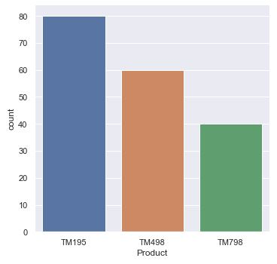
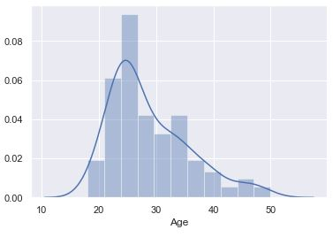
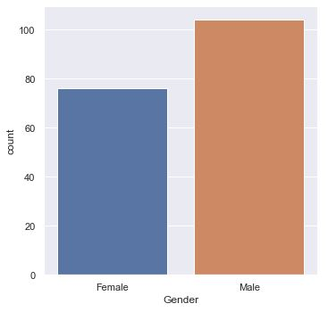
Exploratory Data Analysis – Preliminary Univariate Analysis, Product, Age, Gender
This sample of customers purchased “Products”,
80 x TM195,
60 x TM498,
40 x TM798
Discussion – Can we assume price and features increase as Product number? Likely.
Our customer (M+F) has a mean age of 28.8, but a median age of 26, a range from 18 to 50 years, and a “moderate” right skew of 0.983. We have an IQR of 9 yrs. and a “std” of 6.943. It appears that contrary to popular belief, older adults are buying treadmills! Can we grow sales here in the right tail?
In our customer sample, we have 76 Females and 104 Males. This ~ 0.75/1.00 ratio may have some effect on buying preference, and we’ll need to investigate in the multi-variate section following.
Notes:
Product Lifecycle
We are still in the nascent period of the real Blockchain product market, however, our lead course is already in the Growth/Persuasive Advertising portion of its lifecycle, and requires continuous and diligent revising and updates to stay current and valuable. The sector is moving fast, and the long-term need for our courses will change. We will need to evolve with the market and possibly pivot into new areas, adjacent to our advisors' space.
We have already foreseen the requirement to create new courses that will create overlapping and scalloped summed growth curves, a nice problem to have. While we will stretch our initial courses by continuous editing and improvements, the time to have new courses ready will be soon upon us.
Not our key problem, but a sub-problem, is also the work that will be required to segment and refocus our existing products to reach new professionals who are more interested in the Legal, Policy and Governance aspects of Blockchain Technology, perhaps also with visions of creating an Initial Coin Offering (ICO), which should be called Initial Token Offering (ITO). (Rosic, M. 2016). Our product needs to be expanded into new courses in the specific areas of Legal, Policy and Governance using blockchain/DLT technologies. While we will be using Advisors who have credentials of an accredited Lawyer, Certified/chartered Public Account, or similar, we will need to be very careful on disclosure, that we are not supplying securities advise . One of our advisors and trainers has a formal relationship with the Ontario Securities Commission (OSC), so this will be clarified as we develop new product. I was actually at a Blockchain Hack-a-thon, that was run and supported by the OSC, to investigate the technology at ground level. They are very forward looking and want to guide and protect Canadian (and other) investors in my local space.
The creation of new products to answer to new persona's will be critical to our long term success.
For example, if we were to train a CIO in our initial courses and get them "certified", they won't be certified again; in effect, we have a good ambassador of your brand, however, the same customer is only a customer again, if you have further courses, like the Legal, Policy, Governance course, or create technical developer and programmer courses in blockchain technology, like Ethereum/Solidity/Smart Contract programming, or Hyperledger integration, so that CIO can send his programming and development staff to be trained. (Ethereum Project, nd; Hyperledger Project, 2016)
Without having this portfolio of courses to offer, getting that CxO or VP once, and then not having another course for them, of for their staff, the LTV is low, or stops after the first course, does it not? (Kotler and Keller, ch. 4)
We'll also be doing an Blockchain Architecture course that will appeal to a new segmentation, that of the Enterprise Architect, however that won't be available until later this year.
Reference
Ethereum Project; see https://www.ethereum.org/
Hyperledger Project; see https://www.hyperledger.org/
Kotler, P., Keller, K. 2016. A Framework For Marketing Management, 6th Ed. Pearson Education Limited.
Rosic, M. 2016. What is an ICO? Raising Millions in Seconds. Retrieved from https://blockgeeks.com/guides/initial-coin-offering/
Transformationworx. (2018). Retrieved from https://www.transformationworx.com/
Transformationworx, Board of Advisors. (2018). Retrieved from https://www.transformationworx.com/board-of-advisors
Week 2 Lecture 1 and Lecture 2 Notes.

Slide 5
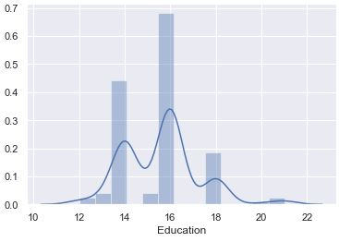
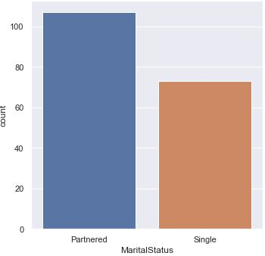
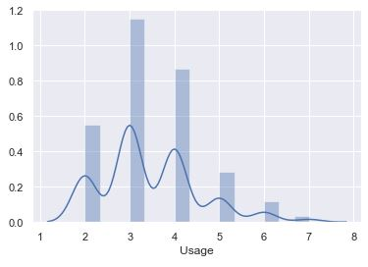
Exploratory Data Analysis – Preliminary Univariate Analysis, Education, Marital Status, Usage
Our customer (F+M) has a mean Education yrs. of 15.57 and a median of 16, a range from 12 to 21 yrs., and a moderate right skew of 0.622.
We have an IQR of 4 yrs. and a “std” of 1.617. The IQR majority are College/Bachelors degree holders (in NA)
In our customer sample for Marital Status, we have 107 Partnered “couples” and 73 Singles. Their buying habits, lifestyle, income, disposable income could have an effect that could be investigated in the multi-variate section following.
In our customer Usage sample, we have a mean usage of 3.455 and a median of 3 times per week, a range from 2 to 7 times and a moderate right skew of 0.739. We have an IQR of 1 and a “std” of 1.085. A mode of 3 suggests 3 times/week is a favored amount.
Notes:
Product Lifecycle
We are still in the nascent period of the real Blockchain product market, however, our lead course is already in the Growth/Persuasive Advertising portion of its lifecycle, and requires continuous and diligent revising and updates to stay current and valuable. The sector is moving fast, and the long-term need for our courses will change. We will need to evolve with the market and possibly pivot into new areas, adjacent to our advisors' space.
We have already foreseen the requirement to create new courses that will create overlapping and scalloped summed growth curves, a nice problem to have. While we will stretch our initial courses by continuous editing and improvements, the time to have new courses ready will be soon upon us.
Not our key problem, but a sub-problem, is also the work that will be required to segment and refocus our existing products to reach new professionals who are more interested in the Legal, Policy and Governance aspects of Blockchain Technology, perhaps also with visions of creating an Initial Coin Offering (ICO), which should be called Initial Token Offering (ITO). (Rosic, M. 2016). Our product needs to be expanded into new courses in the specific areas of Legal, Policy and Governance using blockchain/DLT technologies. While we will be using Advisors who have credentials of an accredited Lawyer, Certified/chartered Public Account, or similar, we will need to be very careful on disclosure, that we are not supplying securities advise . One of our advisors and trainers has a formal relationship with the Ontario Securities Commission (OSC), so this will be clarified as we develop new product. I was actually at a Blockchain Hack-a-thon, that was run and supported by the OSC, to investigate the technology at ground level. They are very forward looking and want to guide and protect Canadian (and other) investors in my local space.
The creation of new products to answer to new persona's will be critical to our long term success.
For example, if we were to train a CIO in our initial courses and get them "certified", they won't be certified again; in effect, we have a good ambassador of your brand, however, the same customer is only a customer again, if you have further courses, like the Legal, Policy, Governance course, or create technical developer and programmer courses in blockchain technology, like Ethereum/Solidity/Smart Contract programming, or Hyperledger integration, so that CIO can send his programming and development staff to be trained. (Ethereum Project, nd; Hyperledger Project, 2016)
Without having this portfolio of courses to offer, getting that CxO or VP once, and then not having another course for them, of for their staff, the LTV is low, or stops after the first course, does it not? (Kotler and Keller, ch. 4)
We'll also be doing an Blockchain Architecture course that will appeal to a new segmentation, that of the Enterprise Architect, however that won't be available until later this year.
Reference
Ethereum Project; see https://www.ethereum.org/
Hyperledger Project; see https://www.hyperledger.org/
Kotler, P., Keller, K. 2016. A Framework For Marketing Management, 6th Ed. Pearson Education Limited.
Rosic, M. 2016. What is an ICO? Raising Millions in Seconds. Retrieved from https://blockgeeks.com/guides/initial-coin-offering/
Transformationworx. (2018). Retrieved from https://www.transformationworx.com/
Transformationworx, Board of Advisors. (2018). Retrieved from https://www.transformationworx.com/board-of-advisors
Week 2 Lecture 1 and Lecture 2 Notes.

Slide 6
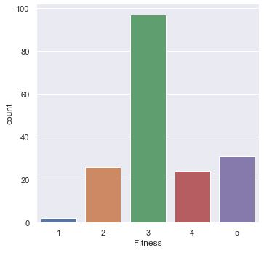
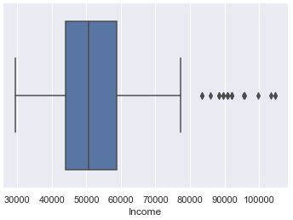
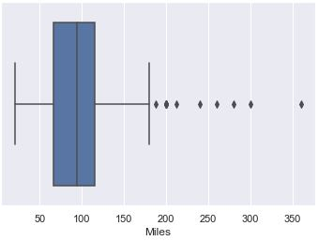
Exploratory Data Analysis – Preliminary Univariate Analysis, Fitness, income, Miles
Our customers’ self-evaluation of Fitness, has a mean of 3.311, a median and obvious mode of 3 with 97 people, a range from 1 to 5, and a small right skew of 0.455. We have an IQR of 1 and a “std” of 0.959. Some 24 & 31 rated themselves 4 and 5 respectively! “Who” are they?
Our customer (M+F) has a mean income of $57720, median $50597, a range $29562-104581, and a “higher” right skew of 1.292. We have an IQR of $14609 and a “std” of $16507. Outliers can be shown as predominately men’s salaries! This needs investigation wrt other variables.
In our customer Miles sample, we have a mean of 103.1 miles, median of 94, a range of 21 to 360, and a high right skew of 1.724. We have an IQR of 48.75 and a “std” of 51.86. The two highest outliers are again Males.
Notes:
Product Lifecycle
We are still in the nascent period of the real Blockchain product market, however, our lead course is already in the Growth/Persuasive Advertising portion of its lifecycle, and requires continuous and diligent revising and updates to stay current and valuable. The sector is moving fast, and the long-term need for our courses will change. We will need to evolve with the market and possibly pivot into new areas, adjacent to our advisors' space.
We have already foreseen the requirement to create new courses that will create overlapping and scalloped summed growth curves, a nice problem to have. While we will stretch our initial courses by continuous editing and improvements, the time to have new courses ready will be soon upon us.
Not our key problem, but a sub-problem, is also the work that will be required to segment and refocus our existing products to reach new professionals who are more interested in the Legal, Policy and Governance aspects of Blockchain Technology, perhaps also with visions of creating an Initial Coin Offering (ICO), which should be called Initial Token Offering (ITO). (Rosic, M. 2016). Our product needs to be expanded into new courses in the specific areas of Legal, Policy and Governance using blockchain/DLT technologies. While we will be using Advisors who have credentials of an accredited Lawyer, Certified/chartered Public Account, or similar, we will need to be very careful on disclosure, that we are not supplying securities advise . One of our advisors and trainers has a formal relationship with the Ontario Securities Commission (OSC), so this will be clarified as we develop new product. I was actually at a Blockchain Hack-a-thon, that was run and supported by the OSC, to investigate the technology at ground level. They are very forward looking and want to guide and protect Canadian (and other) investors in my local space.
The creation of new products to answer to new persona's will be critical to our long term success.
For example, if we were to train a CIO in our initial courses and get them "certified", they won't be certified again; in effect, we have a good ambassador of your brand, however, the same customer is only a customer again, if you have further courses, like the Legal, Policy, Governance course, or create technical developer and programmer courses in blockchain technology, like Ethereum/Solidity/Smart Contract programming, or Hyperledger integration, so that CIO can send his programming and development staff to be trained. (Ethereum Project, nd; Hyperledger Project, 2016)
Without having this portfolio of courses to offer, getting that CxO or VP once, and then not having another course for them, of for their staff, the LTV is low, or stops after the first course, does it not? (Kotler and Keller, ch. 4)
We'll also be doing an Blockchain Architecture course that will appeal to a new segmentation, that of the Enterprise Architect, however that won't be available until later this year.
Reference
Ethereum Project; see https://www.ethereum.org/
Hyperledger Project; see https://www.hyperledger.org/
Kotler, P., Keller, K. 2016. A Framework For Marketing Management, 6th Ed. Pearson Education Limited.
Rosic, M. 2016. What is an ICO? Raising Millions in Seconds. Retrieved from https://blockgeeks.com/guides/initial-coin-offering/
Transformationworx. (2018). Retrieved from https://www.transformationworx.com/
Transformationworx, Board of Advisors. (2018). Retrieved from https://www.transformationworx.com/board-of-advisors
Week 2 Lecture 1 and Lecture 2 Notes.

Slide 7
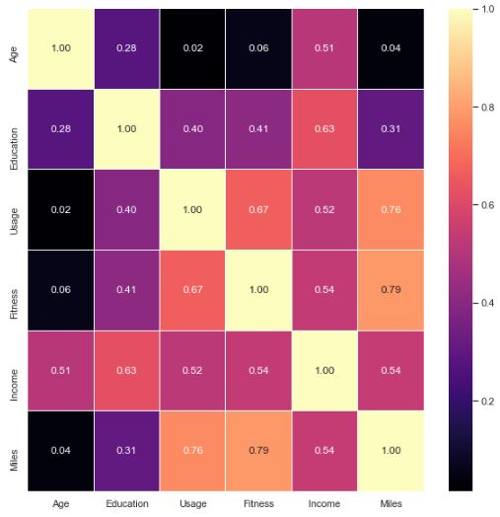
Exploratory Data Analysis - Heatmap
“Correlation does not imply causation,” however, we do have an all-positive heatmap, as one variable increases, the other variable increases.
Income is moderately correlated with Age at 0.51, and Income with Miles and Fitness at 0.54.
At 0.63-0.67, Education, Usage, Fitness and Income have stronger correlations
Fitness and Usage to Miles, have the strongest correlation at 0.76-0.79, which are rather expected.
We will need to investigate these with Product, Gender and Marital Status to bring out some insights and probable conclusions

Slide 8
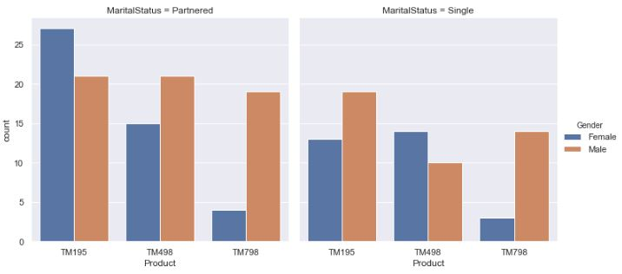
Exploratory Data Analysis Product with Gender and Marital Status
While TM195 outsells TM798 2:1, it’s interesting to note that Males buy significantly more TM798’s than Females, both Partnered or Single
Partnered people buy more on average than single, but partnered Females buy more than 2x TM195 than Female singles
TM498 appeals to more partnered Males than single Females
Marketing needs to take note and tailor their messages, Product Management needs to review, features and costs.
Notes:
Reference
https://www.transformationworx.com/product-page/cio-peer-forum-blockchain-bootcamp-cio-foundational-certification

Slide 9
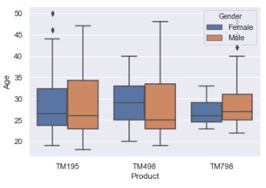
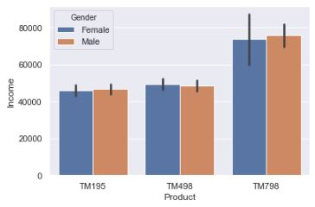
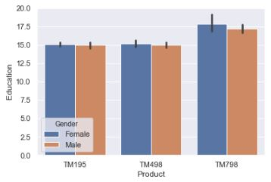
Exploratory Data Analysis Product with Age, Income, Education.
Age doesn’t seem to be a good predictor of Product purchase, TM195 has the largest IQR’s but similar to TM498. Some outliers, but TM798 has a much tighter IQR.
There’s only a slight difference on Income being a predictor as to a TM195 or TM498 purchase. However, the TM798 purchasers have incomes ~50% higher, genuinely a luxury model.
Similarly, the larger number of education years for the TM798 is correlated to Income with a value of 0.63, allowing those people more income to purchase the highest (cost) model.
Notes:
Reference
https://www.transformationworx.com/product-page/cio-peer-forum-blockchain-bootcamp-cio-foundational-certification

Slide 10
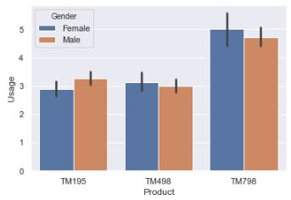
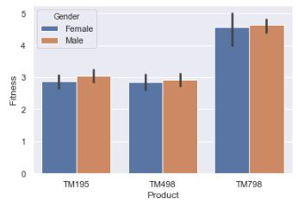
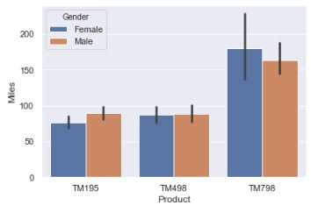
Exploratory Data Analysis Product with Usage, Fitness, Miles.
Usage, Fitness, Miles had the largest correlations in the heatmap, 0.76 to 0.79, and TM798 users achieve ~50% more usage than the mode of 3.
Again, TM798 users are the predominately the 4’s and all of the 5’s, and a very “similar” look to Usage. Moderate Fitness and Usage levels are satisfied with TM195/498.
The Miles champions also use the TM798 nearly 2:1, while perhaps a better featured and more costly model, referring to previous page. But is TM195 still what “keeps the lights on?”
Notes:
Reference
https://www.transformationworx.com/product-page/cio-peer-forum-blockchain-bootcamp-cio-foundational-certification

Slide 11
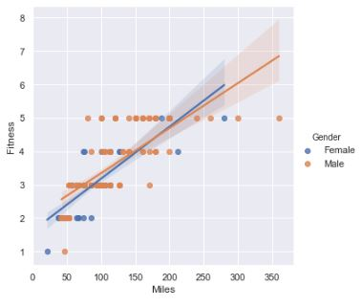
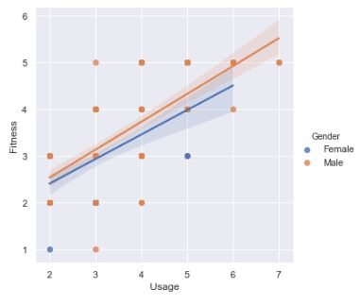
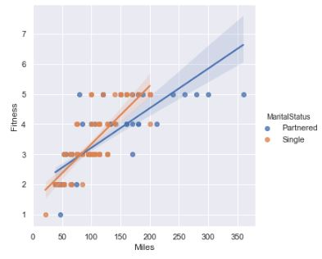
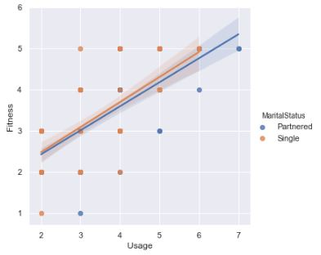
Exploratory Data Analysis Confirming Trends of Fitness with Miles and Usage
The EDA shows that there is a “common” positive correlation of Fitness and Usage, very similar across Gender and Marital Status. Of interest is the slightly higher “slope” of singles in the Miles / MaritalStatus graph; but remember these were customer self-ratings, so dubious at best. Ego perhaps?
Notes:
Reference
https://www.transformationworx.com/product-page/cio-peer-forum-blockchain-bootcamp-cio-foundational-certification

Slide 12
Conclusions and Recommendations - 1
Observation and Conclusions | Recommendations
Of the 180 units sold, there was 80 x TM195, 60 x TM498, 40 x TM598. However, is that the best mix for the company? | Create an objective function with limitations using quantity, costs and margins, and review what a maximized mix might look like? Confer with the right stakeholders and Product Managers
Our customer (M+F) has a mean age of 28.8, but a median age of 26, a range from 18 to 50 years. There is “room” in the right-skewed tail for growth. | Advertising and Marketing targeting an older audience may sell more of the entire line and perhaps more TM498’s and TM598’s, as an older audience may be looking for more refined features
In our customer sample, we have 76 Females and 104 Males. Using census.gov, the 2010 gender ratio in the USA population was approximately 50.8% Female and 49.2% Male. | Improve the ratio of Female to Male, while maintaining the Male base. Use a more female-friendly sales and marketing approach, target the female audiences with more thoughtful marketing in sales.
There is a noted difference in slightly more educated people buying the TM598. | Advertise where that slightly more educated population is to entice more of them to buy the products, as they may also buy the model TM498 if the TM598 is too much for their budget.
Notes:
Reference
https://www.transformationworx.com/product-page/cio-peer-forum-blockchain-bootcamp-cio-foundational-certification

Slide 13
Conclusions and Recommendations - 2
Observation and/or Conclusions | Recommendations
The customers self-evaluation of their fitness, is this a good metric? | There are indicators in the EDA that the self-evaluation helps the customer choosing the TM498 and TM598, over the TM195 “base” model – leave this practice in place
Our customer (M+F) has a mean income of $57720, median $50597, a range $29562-104581, and a large right skew of ~1.3. There is possibly “room” to push the curve up in the higher incomes, selling more TM598 and TM498 | Advertising and Marketing targeting an older audience may sell more of the entire line and perhaps more TM498’s and TM598’s, as an older audience may be looking for more refined features
While TM195 outsells TM798 2:1, it’s interesting to note that Males buy significantly more TM798’s than Females, both Partnered or Single | As part of the female-friendly marketing and sales, present the TM598 with different collateral or investigate some feature improvement in the TM498 or sale pricing of the TM598.
Partnered people buy more on average than single, but partnered Females buy more than 2x TM195 than Female singles | Investigate where/why the single Female sales are slipping compared to partnered Females
Notes:
Reference
https://www.transformationworx.com/product-page/cio-peer-forum-blockchain-bootcamp-cio-foundational-certification

Slide 14
Conclusions and Recommendations - 3
Observation and/or Conclusions | Recommendations
Higher Income is genuinely as predictor of TM598 purchases compared to those who purchase TM498 and TM195. | Depending on margins and profitability, do a sensitivity analysis or actual market testing of pricing of the “higher” models. However, if the “luxury” TM598 is profitable and solves a market segment, then a change may not be warranted.
Notes:
Reference
https://www.transformationworx.com/product-page/cio-peer-forum-blockchain-bootcamp-cio-foundational-certification

